Slide 1
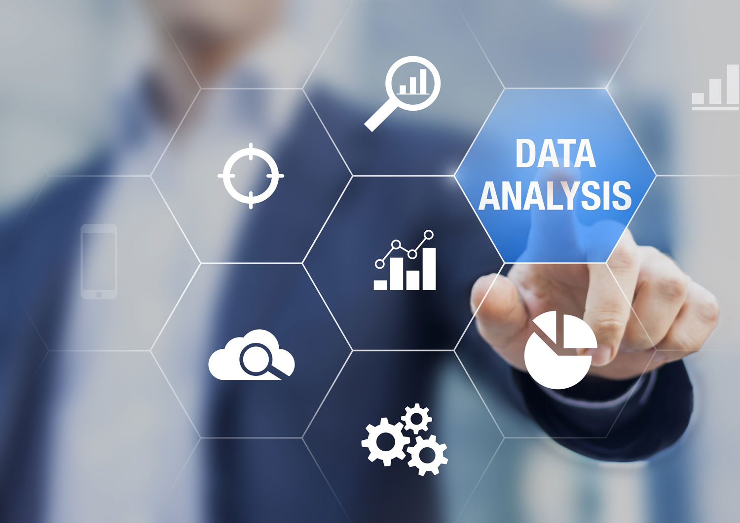

Overview of
Engineering Analytics & Machine Learning
(ECSE202)

Slide 2
Subject Synopsis
This subject provides coverage of the knowledge of concepts and skills in the tools and processes used in data analytics of large amounts of engineering data. It encompasses the various stages of data analytics, from gathering the data, asking the right questions, to analyzing and interpreting data, identifying patterns and trends and making use of machine learning and predictive models to make intelligent and actionable recommendations for improvement in engineering systems.

Slide 3
Subject Aims
This subject aims to equip students with the knowledge and skills to:
• apply the processes needed to perform analysis on engineering data.
• present results in the form of visualization.
• apply machine learning algorithms on engineering data.

Slide 4
Subject Intended Learning Outcomes
Demonstrate basic application for data handling.
Perform data gathering and pre-processing.
Analyze data using visualization techniques.
Perform Machine Learning methods on a data set.
We will be using Python in this subject.
Notes:
Emphasize that we are using the software RapidMiner in this subject to fulfill the intended learning outcomes. As for programming knowledge and skills, it is mainly graphical programming (icon-based), hence all ENG students should be able to pick up easily, and not be bogged down by coding. Instead, the emphasis of the subject is on going through the data analytics process, starting from asking a question, to data collection and all the way till presenting the data (visualization) and coming to a conclusion to the question.

Slide 5
Data Analytics Process &
Motivation for Data Analytics

Slide 6
Why Engineering Analytics?
Notes:
Data Analytics has been identified as one of those emerging trends in the SkillsFuture skills framework for the Electronics industry. With Industrial IoT, there will be tremendous amount of data (sensor data) collected from industrial systems, such as robots, PLCs and machines. Eventually, these data needs to be analyzed in order to help improve the efficiency of the manufacturing process.
Engineering Analytics is basically Data Analytics, but grounded in engineering applications.

Slide 7
What is Data Analytics?
Data analytics is the process of inspecting, cleansing, transforming and modelling data with the goal of discovering useful information, suggesting conclusions and supporting decision making.
Wikipedia
Notes:
Emphasize the importance of the flow diagram as this is the process in which students will be going through.
Data Analytics starts from asking a question. Based on the question, the appropriate form of data transformation can then be determined.

Slide 8
Data Analytics --- why now?
Easy access to high speed and cheap connection
Availability of cheap storage
Smart sensors and devices comes of age
Easily available and increasing computational power
Ever changing and rapidly business environment
Notes:
Data Analytics is not something new. It has been there all the while, now there is a buzzword and the hype surrounding it. This slide shows the combination of factors that highlights the emergence of the current trends on data analytics.

Slide 9
Types of Data Analytics
Descriptive Analytics
What happened?
Uses historical data to give a perspective of what is going on
Diagnostic Analytics
Why did it happen?
What and why it went wrong?
Predictive Analytics
What is going to happen?
Building mathematical model using historical data
Prescriptive Analytics
What could we do about it?
Find the best actions to achieve desired goal
Notes:
In this subject, we will focus more on descriptive analytics (“Tell a story”) and a small portion on prescriptive analytics.
Good to provide an example for each type of analytics.

Slide 10
Data Analytics Process
The process can be iterative. After Visualization and Modelling, the data analyst can decide that more data needs to be collected or new features need to be extracted, and goes back to those stages.

Slide 11
Data Collection
It is the input of the Data Analytics process and solely responsible for the quality of the analysis.
The data has to be reliable and quantifiable.
Notes:
Data collection is the process of gathering and measuring information on targeted variables in an established systematic fashion, which then enables one to answer the question and evaluate outcomes.

Slide 12
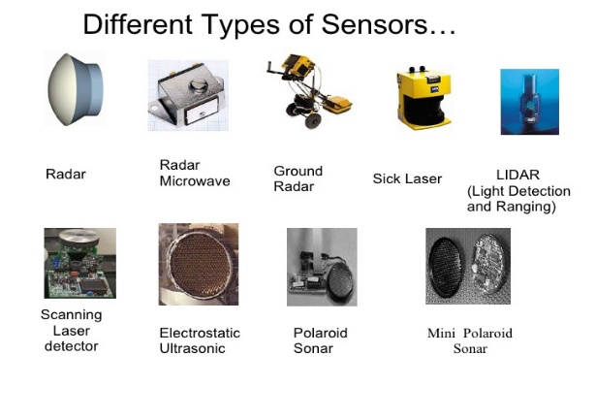

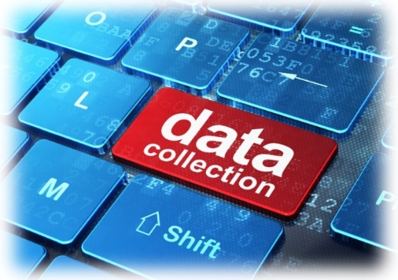


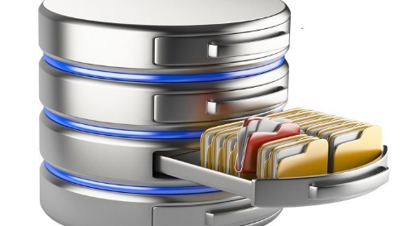


Data Collection – Data Source
Time Series, Unstructured, Noisy
and prone to missing data
Structured/unstructured, involved using of API to access, real-time
Structured and large
Local, easy access but limited
Notes:
There are many different sources of data that can be analyzed. For Engineering Analytics, we are grounded on engineering applications. Hence, we will be mainly dealing with engineering data (e.g. sensor data) which are typically time series, unstructured, noisy and prone to missing data. Briefly explain about time series and unstructured and provide examples of such sensor data.

Slide 13

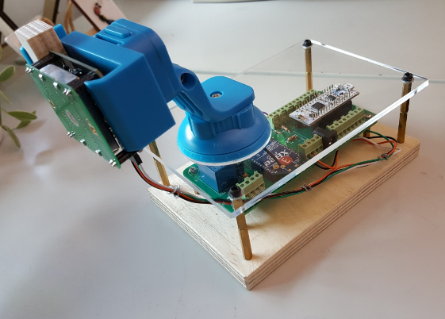
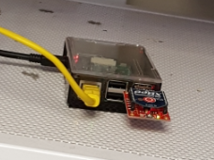
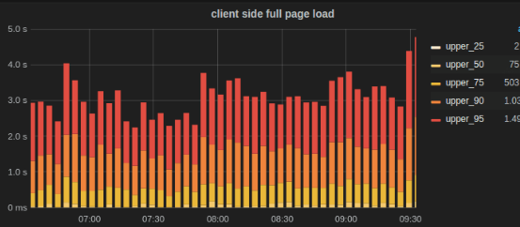
Example of Sensor Data: RemoteEye
IoT Gateway (Raspberry Pi)
Server (Desktop)
ZigBee-based wireless network
serial
MQTT
Client
MQTT Broker
MQTT-to-InfluxDB
LAN wired connection
Embedded device with microwave-sensor
InfluxDB Storage
Grafana Visualisation
Notes:
RemoteEye is a IoT project developed by a team of staff whose motivation came from an article in ST.
Motivation: Elderly people who live alone are at risk of passing on without neighbours knowing. An article in the Straits Times on 10 April 2016 highlighted this social issue (Figure 1).
Scope: In this proposed project, non-image based sensors shall be used to monitor the activities of these elderly people. Data collected from sensors can be used to facilitate activity-aware IoT applications. These applications can enable family members or neighbours to look out for their loved ones or their elderly neighbours.

Slide 14
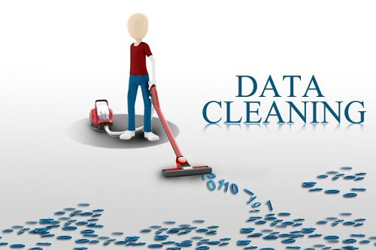
Data Cleaning
This is an important stage and is necessary because the data that is collected is often “dirty” due to:
Missing data
Unacceptable formats
Erroneous values
Data could be embedded inside text or other information and needs to be extracted
Remove or compensate for outliers that skews the data unrealistically
Notes:
Briefly explain on each of the pointers.
Missing data – common in sensor data as explained earlier
Unacceptable format – e.g. an attribute is of date-time type imported as a string (polynomial)
Erroneous values – possibility due to sensor not properly calibrated

Slide 15
Data Cleaning
Huge amount of effort is spent cleaning data to get it ready for analysis.
It is often said that 80% of data analysis is spent on the process of cleaning and preparing the data.
Data preparation is not just the first step, but must be repeated over the course of analysis as new problems come to light or new data is collected.
Data cleaning is sometimes painfully manual.

Slide 16
Data Transformation / Feature Extraction
Data Cleaning:
To address problems with the raw data, such as missing and erroneous values, data formatting issues etc.
Data Transformation:
To enhance the data by changing the values and/or structure of the data and add additional features (feature extraction)

Slide 17
Data Transformation / Feature Extraction
Some of the data transformation which will be covered in this subject include:
Date Time processing
Normalize
Aggregate
Generate New Attributes
Select Attributes
Filter Examples

Slide 18
Applications of Data Analytics
Industrial Internet of Things (IIOT) --- big data for manufacturing
https://www.youtube.com/watch?v=sGXvZbo3l9I
Amazon Logistic Robot https://www.youtube.com/watch?v=cLVCGEmkJs0

Slide 19

Introduction to Machine Learning

Slide 20

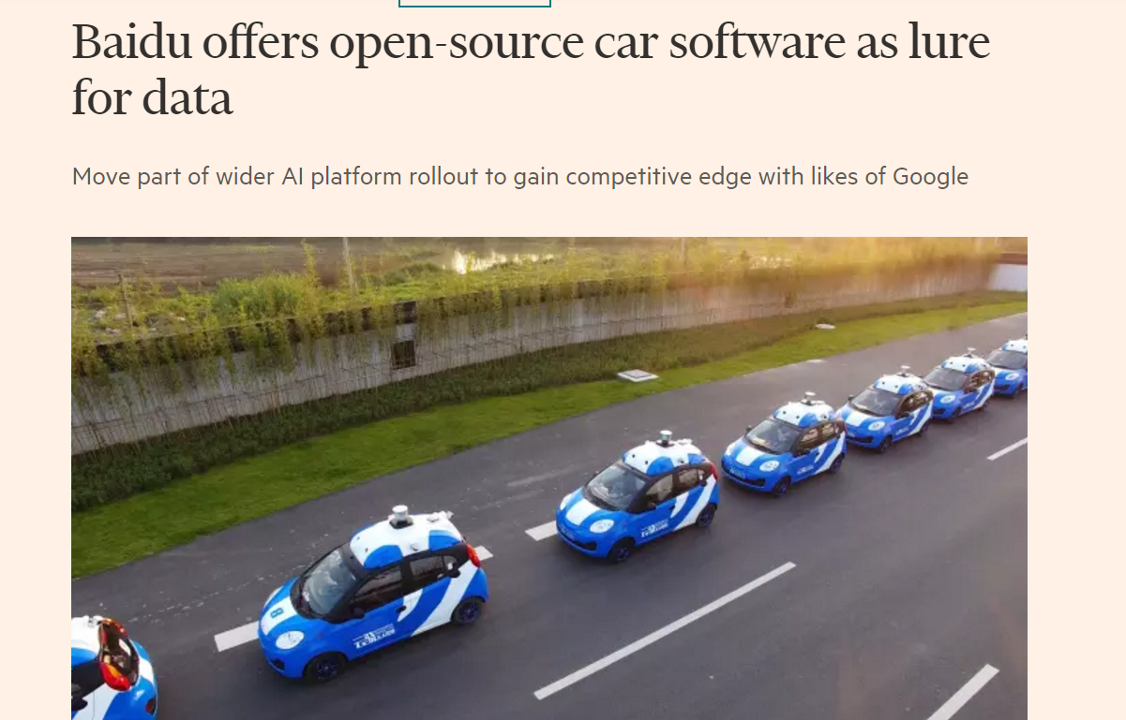
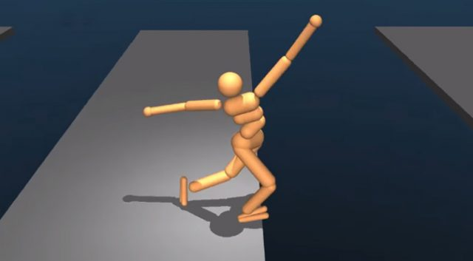
https://www.youtube.com/watch?v=gn4nRCC9TwQ Google AI walk
Source: https://www.ft.com/content/55e79944-6168-11e7-91a7-502f7ee26895
Notes:
Let the student watch the Google AI walk video
Explain that the AI software is not taught to walk but learn on it own
The real machine learning is to let the machine learn on its own

Slide 21
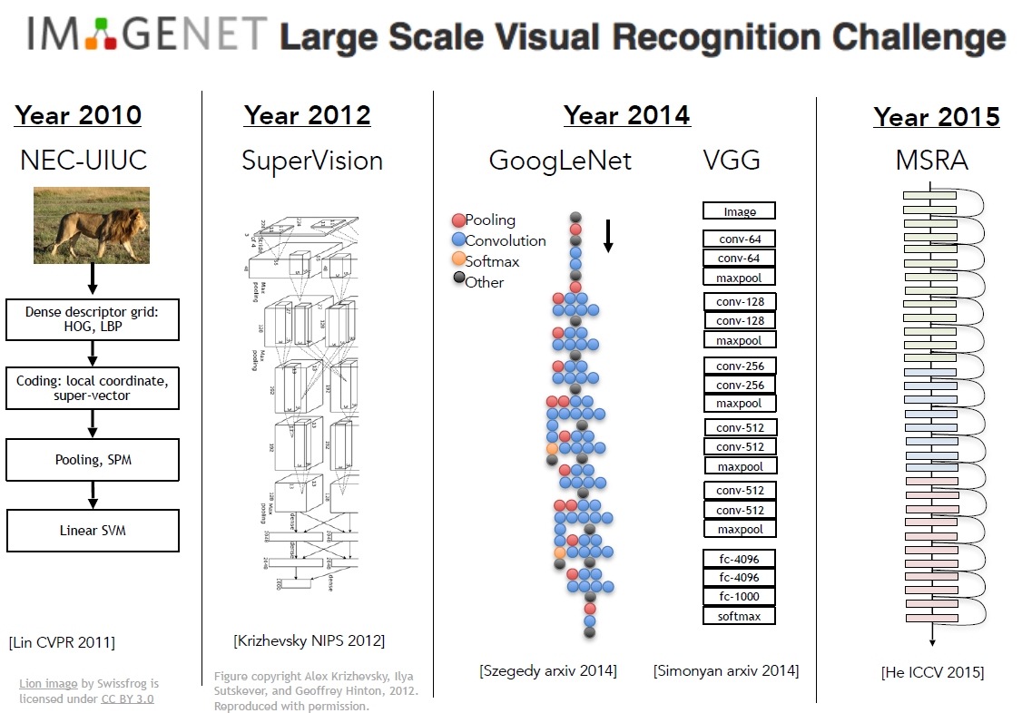
Notes:
Machine learning/AI such as Deep learning had gained so much improvement so much so that in 2015 is the last competition as the accuracy is already pretty high

Slide 22

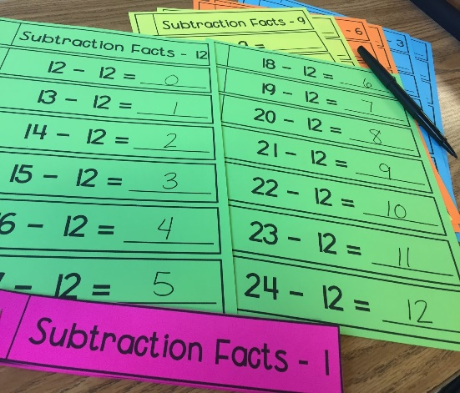
Human Learning
Show sample of examples for learning
Not for the kid to be fixed to the material
Able to apply
Able to extrapolate
Able to adapt to similar cases
Able to innovate

Slide 23
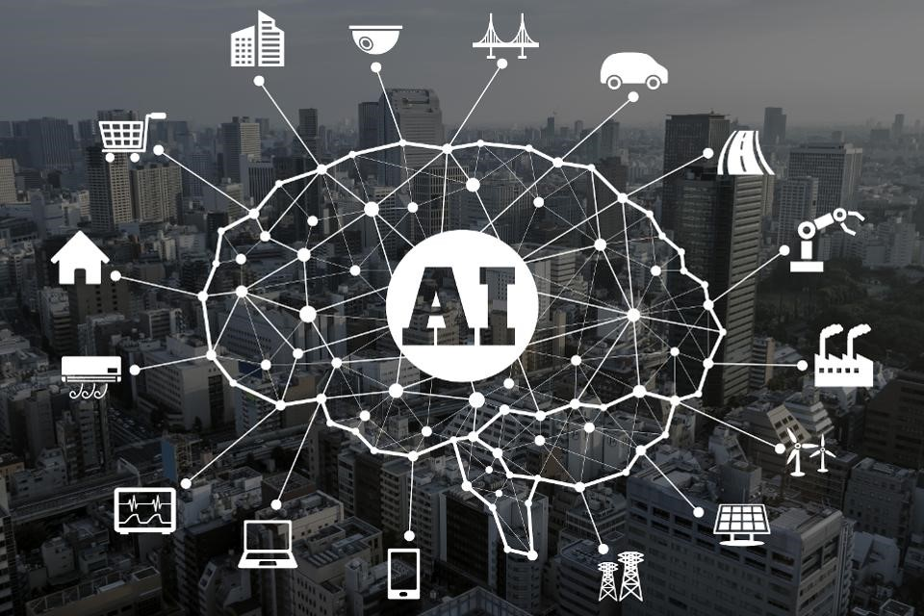
Generalize
Not to fit the train data

Slide 24
Supervised and Unsupervised Learning
Different type of machine learning methods
 | Supervised Learning | Unsupervised Learning
Characteristic | Known number of classes Based on a training set with correct label Use to predict/classify future observations | Number of classes unknown No prior knowledge Used to understand/explore data
Algorithms | Linear Regression Logistic Regression SVM Decision Tree Deep Learning Neural Network | PCA K-means Hidden Markov Model

Slide 25

Introduction to Python
for Data Science

Slide 26
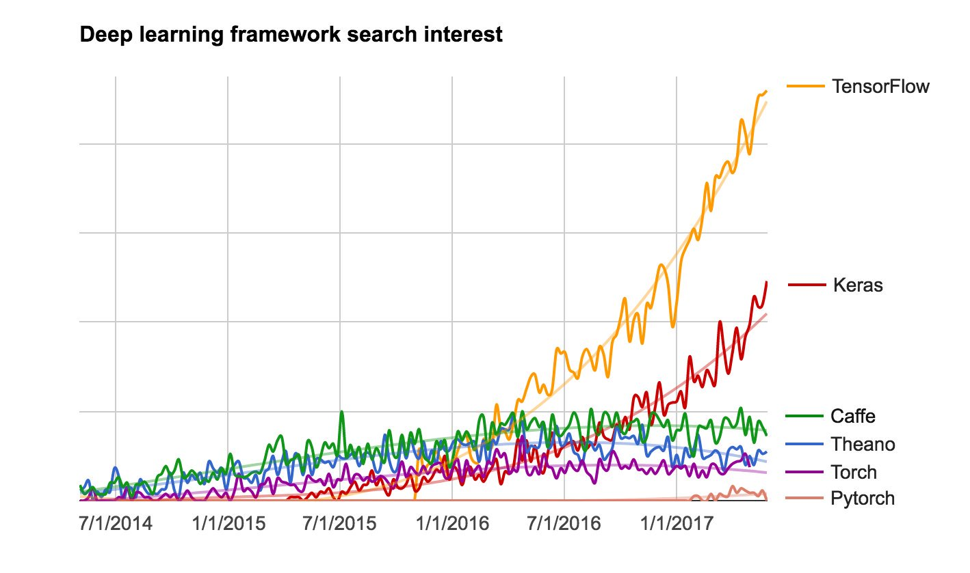
Learning Strategy
Why Python

Slide 27
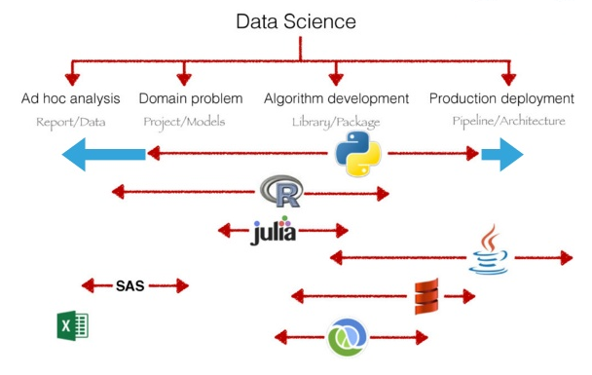
Learning Strategy
Why Python
Source: https://www.slideshare.net/icaromedeiros/why-python-is-better-for-data-science

Slide 28
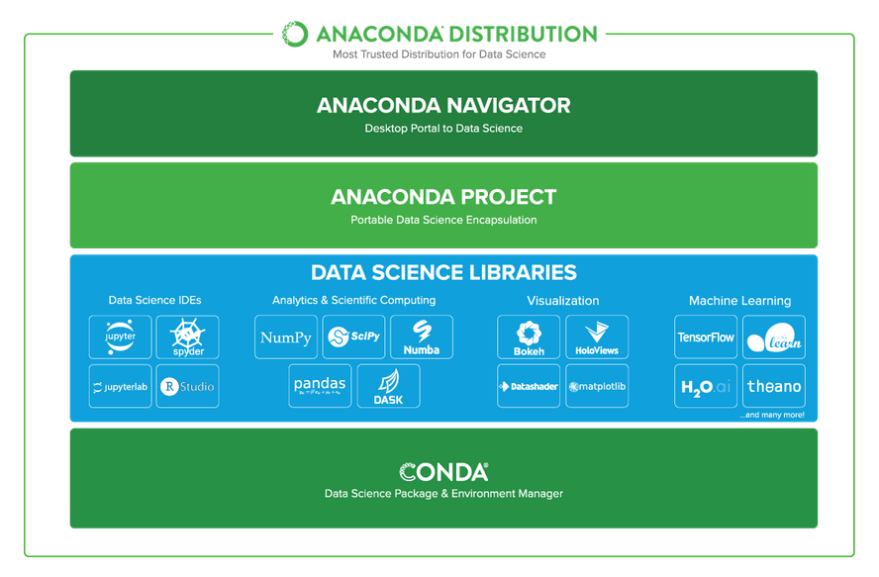
Learning Strategy
Anaconda Virtual Environment

Slide 29
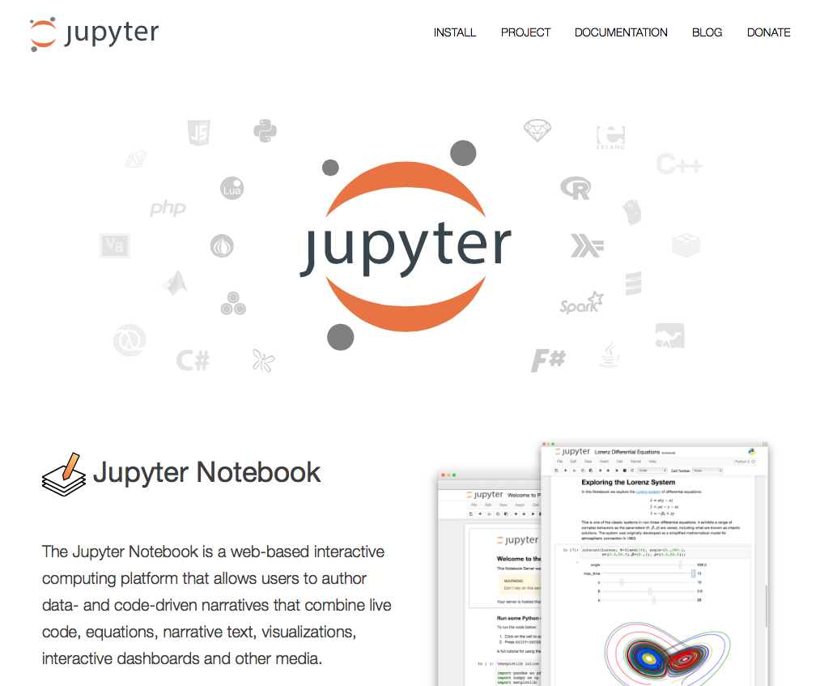
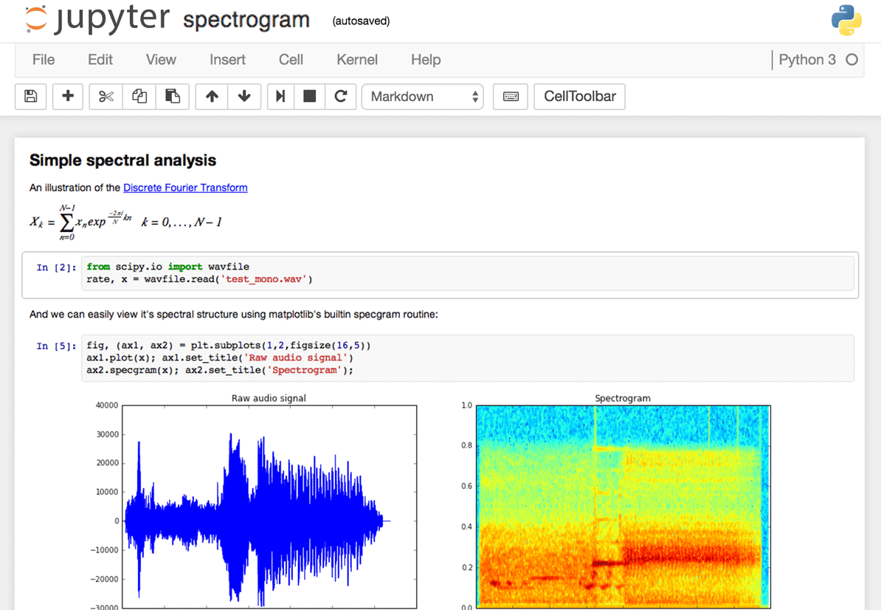
Learning Strategy
Juypter Notebook

Slide 30
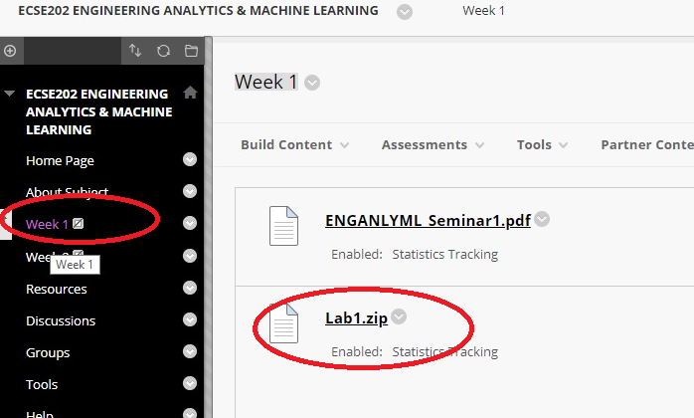
Lab Setup
Go to Polymall
Access the current week folder e.g. Week 1
Click on the Lab1.zip link to download the files

Slide 31
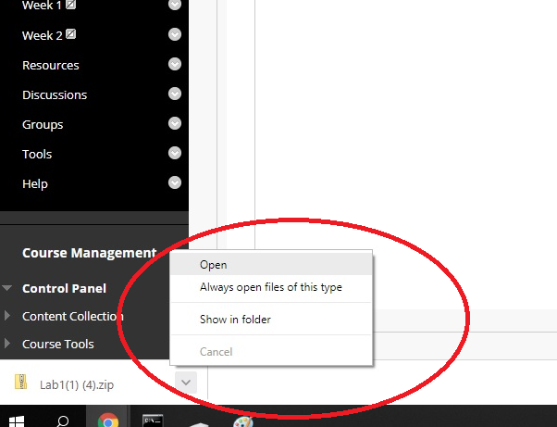
Lab Setup
When file download completed, select open to open the zip file
Due to user right setting of lab machine it may not work if you choose to save the file

Slide 32
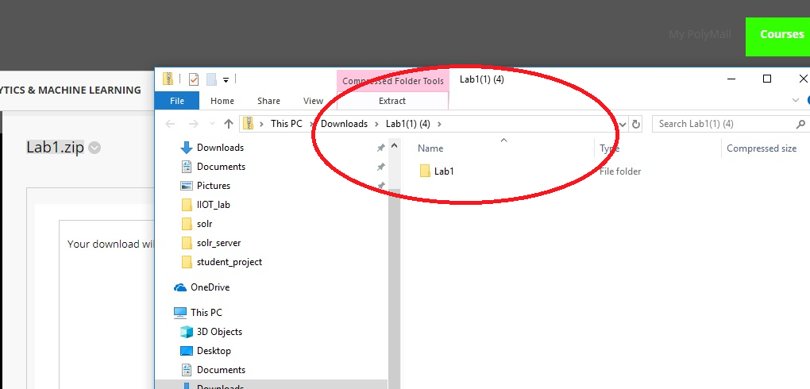
Lab Setup
An explorer would be activate and show you the content of the zip file which usually is a folder with name such as Lab1, Lab2 and etc

Slide 33
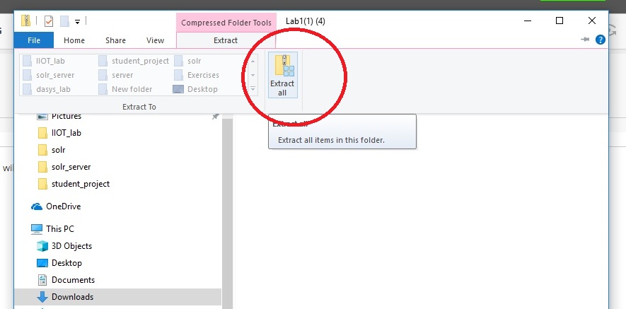
Lab Setup
Select Extract All to uncompressed the zip file

Slide 34
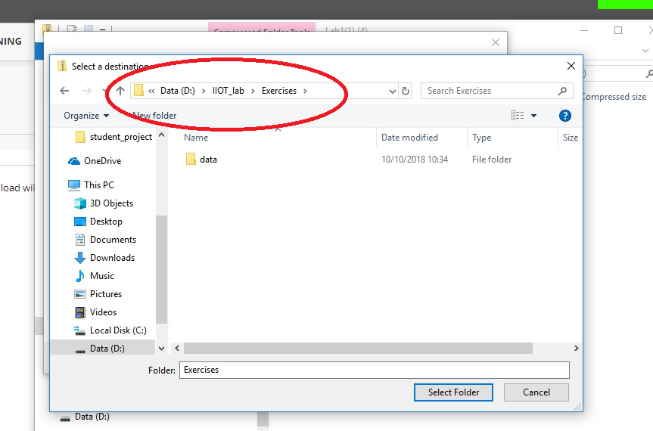
Lab Setup
Navigate to d:\IIOT_lab\Exercise to extract the content to this folder
Due to user right setting, other folder may not work.

Slide 35
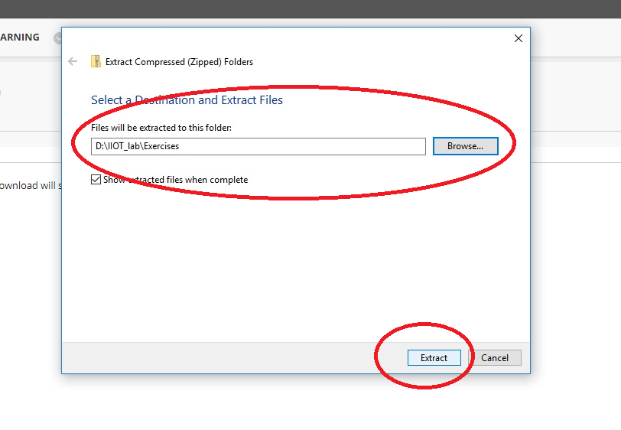
Lab Setup
Finally ensure you are extracting ot the right folder and click Extract.

Slide 36
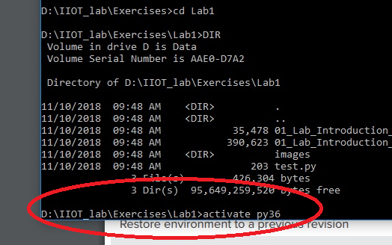
Lab Setup
Open a Command Prompt Terminal
Navigate to the folder you said the lab content
Run “activate py36” to activate the anaconda environment for our lab

Slide 37
Lab Setup
Open a Command Prompt Terminal
Navigate to the folder you said the lab content
Run “activate py36” to activate the anaconda environment for our lab

Slide 38
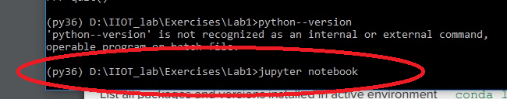
Lab Setup
If py36 is successfully activated, you would see (py36) beside your command prompt
To quit py36 environment, you may use the command “deactivate”
Run the command “jupyter notebook” to activate the Jupyter environment for our lab

Slide 39
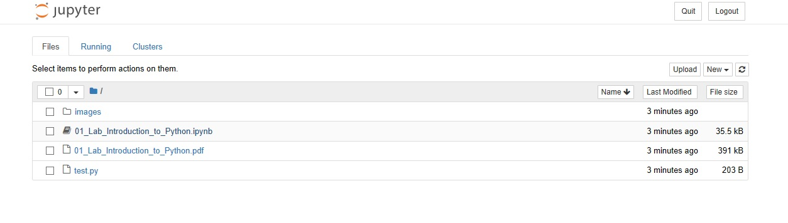
Lab Setup
If successful, the default browser would be activate to start with the Jupyter Notebook navigator.
You may click on the 01_Lab_Introduction_to_Python.ipynb to start the lab

Slide 40
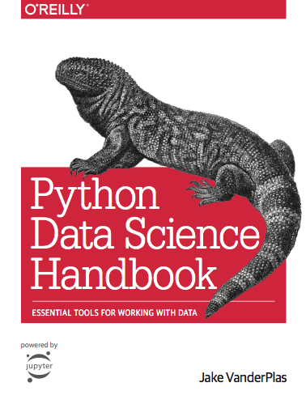
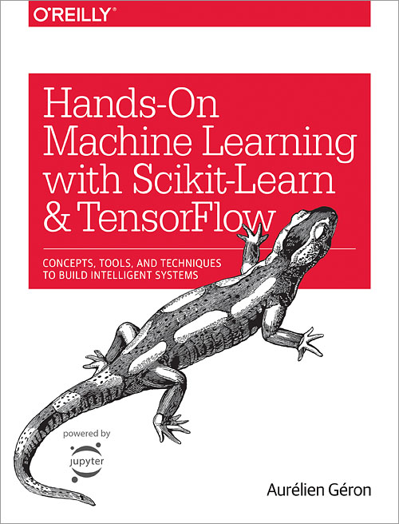
Reference

